Slide 1
Week 3
CSE 20 Fall 2020
Propositional Logic
Logical Operators

Slide 2
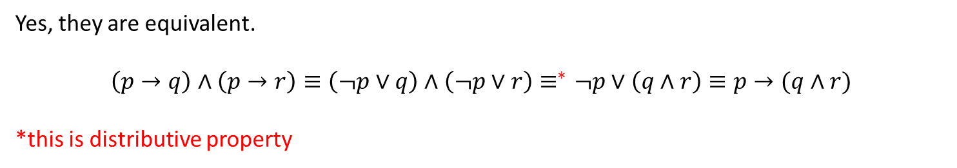

Propositional Logic
Question: Are the following propositions equivalent?
$\left(p→q\right)∧(p→r)$ and $p→(q∧r)$
Yes, they are equivalent.
$$\left(p→q\right)∧\left(p→r\right)≡\left(¬p∨q\right)∧\left(¬p∨r\right)≡^{∗}¬p∨\left(q∧r\right)≡p→(q∧r)$$
*this is distributive property

Slide 3
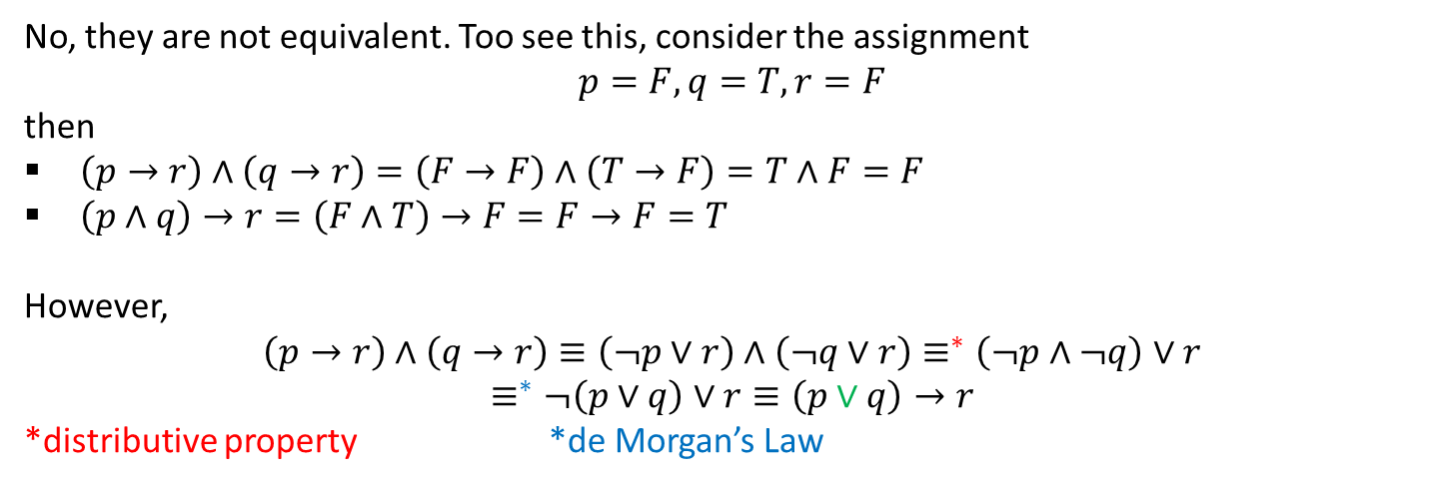

Propositional Logic
Question: Are the following propositions equivalent?
$\left(p→r\right)∧(q→r)$ and $\left(p∧q\right)→r$
No, they are not equivalent. Too see this, consider the assignment
$$p=F, q=T, r=F$$
then
$\left(p→r\right)∧\left(q→r\right)=\left(F→F\right)∧\left(T→F\right)=T∧F=F$
$\left(p∧q\right)→r=\left(F∧T\right)→F=F→F=T$
However,
$$\left(p→r\right)∧\left(q→r\right)≡\left(¬p∨r\right)∧\left(¬q∨r\right)≡^{∗}\left(¬p∧¬q\right)∨r$$
$$≡^{∗}¬\left(p∨q\right)∨r≡\left(p∨q\right)→r$$
*distributive property *de Morgan’s Law

Slide 4
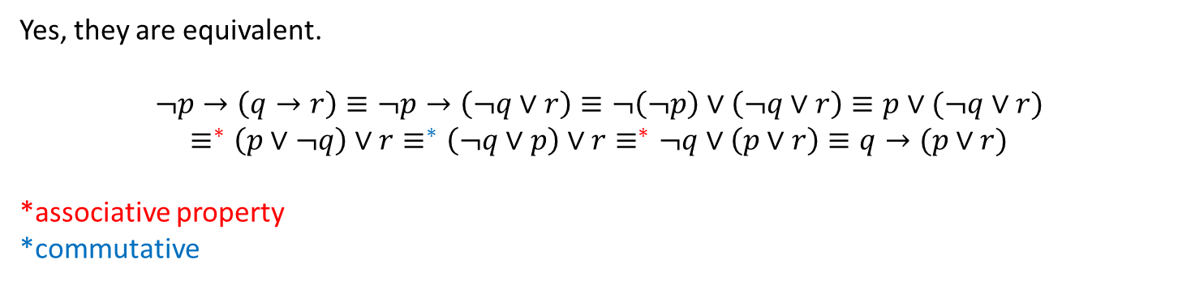

Propositional Logic
Question: Are the following propositions equivalent?
$¬p→(q→r)$ and $q→(p∨r)$
Yes, they are equivalent.
$$¬p→\left(q→r\right)≡¬p→\left(¬q∨r\right)≡¬\left(¬p\right)∨\left(¬q∨r\right)≡p∨(¬q∨r)$$
$$≡^{∗}\left(p∨¬q\right)∨r≡^{∗}\left(¬q∨p\right)∨r≡^{∗}¬q∨\left(p∨r\right)≡q→(p∨r)$$
*associative property
*commutative

Slide 5
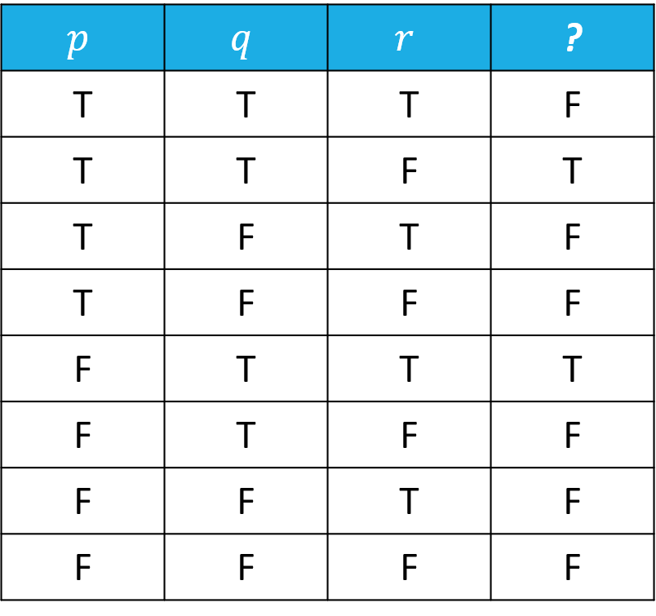



Propositional Logic
Simplify the following truth table:
$$p∧q∧¬r$$
$$¬p∧q∧r$$
$$\left(p∧q∧¬r\right)∨(¬p∧q∧r)$$
$$\left(p∧q∧¬r\right)∨\left(¬p∧q∧r\right)≡\left(q∧\left(p∧¬r\right)\right)∨\left(q∧\left(¬p∧r\right)\right)≡q∧\left(\left(p∧¬r\right)∨\left(¬p∧r\right)\right)≡q∧(p⊕r)$$

Slide 6
Propositional Logic
Converse of $p→q$:
Contrapositive of $p→q$:
Inverse of $p→q$:
p: “Maria learns discrete mathematics”
q: “Maria will find a good job.”
Express the statement p → q as a statement in English.
“If Maria learns discrete mathematics, she will find a good job”

Slide 7
Propositional Logic
Write the following statement as a proposition:
“The home team wins whenever it is raining.”
p:
It is raining.
q:
The home team wins.
$p→q$: If it is raining, the home team wins.
$q→p$: If the home team wins, then it is raining.
Converse:
Contrapositive:
$¬q→¬p$: If the home team does not win, then it is not raining.
$¬p→¬q$: If it is not raining, then the home team does not win.
Inverse:
Observe: The contrapositive is the same as the original

Slide 8

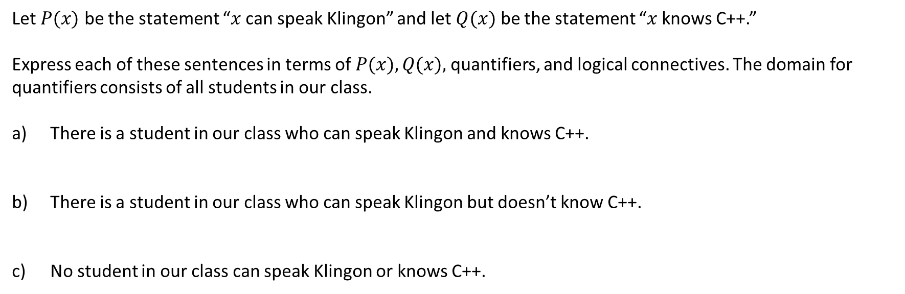


Quantifiers
Let $P(x)$ be the statement “$x$ can speak Klingon” and let $Q(x)$ be the statement “$x$ knows C++.”
Express each of these sentences in terms of $P(x), Q(x),$quantifiers, and logical connectives. The domain for quantifiers consists of all students in our class.
There is a student in our class who can speak Klingon and knows C++.
There is a student in our class who can speak Klingon but doesn’t know C++.
c) No student in our class can speak Klingon or knows C++.
$$∃x(P\left(x\right)∧Q(x))$$
$$∃x(P\left(x\right)∧¬Q(x))$$
$$¬∃x\left(P\left(x\right)∨Q\left(x\right)\right)≡∀x(¬P\left(x\right)∧¬Q(x))$$

Slide 9
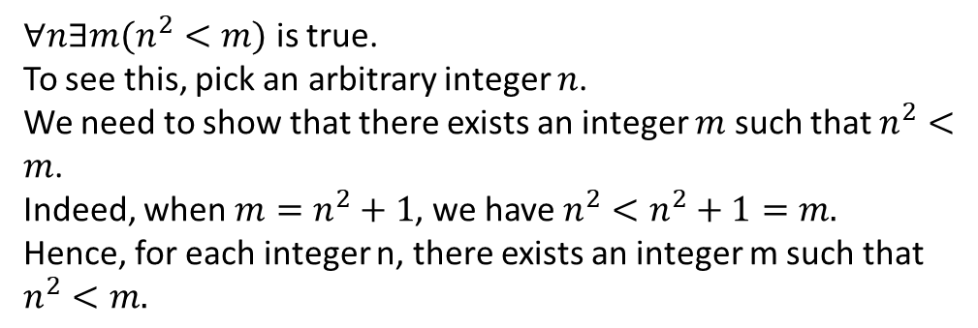
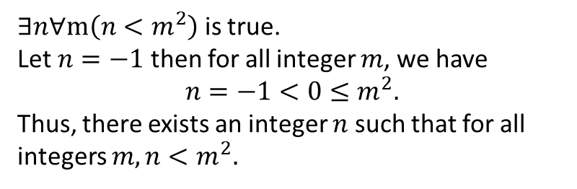
Quantifiers
What is the truth value of
$∀n∃m(n^{2}<m)$ $∃n∀m\left(n<m^{2}\right)$
The domain is the set of integers.
$∀n∃m(n^{2}<m)$ is true.
To see this, pick an arbitrary integer $n$.
We need to show that there exists an integer $m$ such that $n^{2}<m$.
Indeed, when $m=n^{2}+1$, we have $n^{2}<n^{2}+1=m.$
Hence, for each integer n, there exists an integer m such that $n^{2}<m.$
$∃n∀m\left(n<m^{2}\right)$ is true.
Let $n=−1$ then for all integer $m$, we have
$$n=−1<0≤m^{2}.$$
Thus, there exists an integer $n$ such that for all integers $m, n<m^{2}.$

